Slide 1


Slide 2

Agenda
Problem Statement
Natural Language Processing
submitted model
Models cumbering
Limitation & challenges

Slide 3


Slide 4






Natural Language Processing (NLP)
Data preprocessing
Feature extraction
Model training
Model evaluation
Hyperparameter tuning

Slide 5





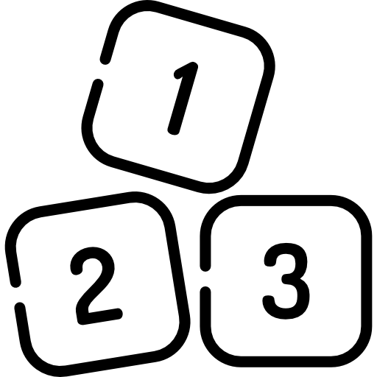



Cleaning data
Data preprocessing
Null
punctuation
Litter case
Numbers
Stop word
Lemmatization/Stemming
Tokenization

Slide 6






MIX AND MATCH
X features
Feature Engineering
Model Selection
Model Evaluation
Hyperparameter tuning
TF-IDF
Random forest
Date
Teitel
Word2Vec
Linear Regration
Subject
SVM
Fast text
Text
.
.
.
.
Naïve Bayes
.
.
.
.

Slide 7
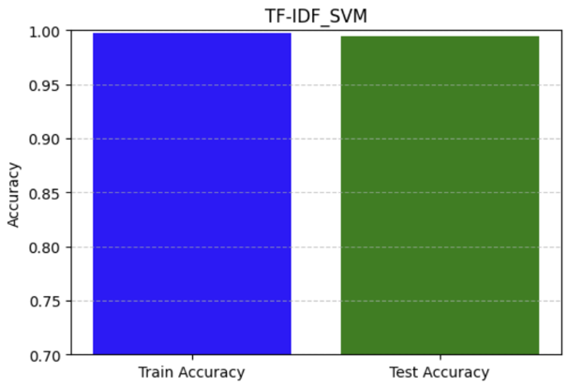
submitted model
X features
Feature Engineering
Model Selection
Model Evaluation
Text
Titel
Subject
TF-IDF
SVM
Metric | Value
Accuracy | 0.993992
Precision | 0.993995
Recall | 0.993992
F1 Score | 0.993992

Slide 8
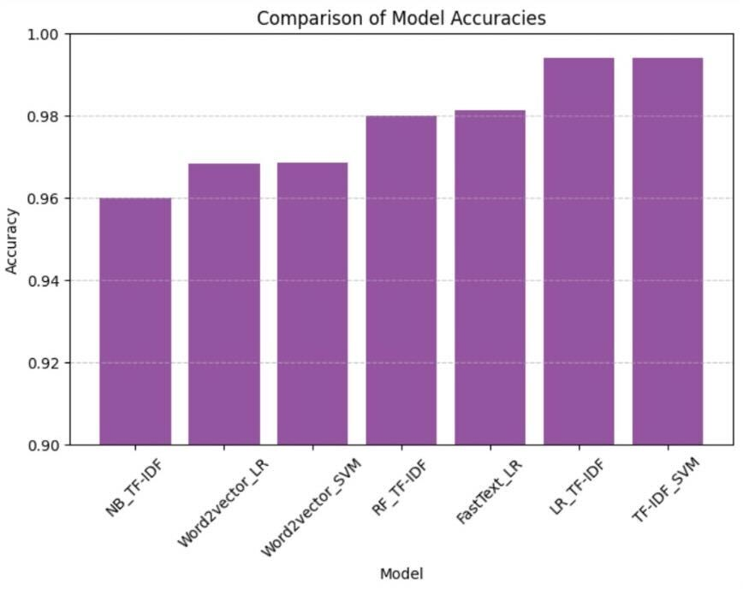
Models cumbering
Models cumbering

Slide 9

Limitation & challenges
Limitation
challenges
Numbers of choices

Slide 10

Distribution of work among team members
Team members cooperate to accomplish the task.

Slide 11
Essa
Alhanouf
Malak
Amjad

